Slide 1
Oracle SQL
Abed Sharifi
Oracle DBA
SQL Developer
Abed.sharifi@gmail.com

Slide 2
What is SQL ?
SQL (Structured Query Language)
SQL is a computer language aimed to store, manipulate, and retrieve data in relational databases.
SQL lets you access and manipulate databases
SQL is an ANSI (American National Standards Institute) standard

Slide 3
Database concepts
Database
Linking data tables through relationships
Controlling data storing and retrieving
Maintaining data integrity and accuracy
Avoiding data redundancy and inconsistency
Sorting and filtering data

Slide 4
Relational Database
a relational database is a set of tables
Each table keeps information about one thing

Slide 5
Relational Database Management System (RDBMS)
is an application that creates, organizes and edits databases
Microsoft SQL Server
Oracle
Microsoft Access

Slide 6
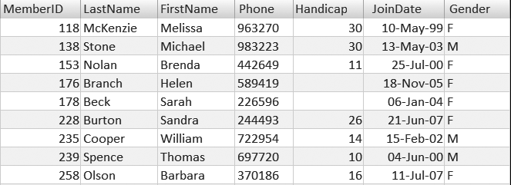
Table Elements

Slide 7
Data Types

Slide 8
Data Type
System Data Type
User Defined Data Type

Slide 9
Data Type Categories
Character Datatypes
Number Datatype
DATE Datatype
LOB Datatypes
RAW and LONG RAW Datatypes
ROWID and UROWID Datatypes
https://docs.oracle.com/database/121/SQLRF/sql_elements001.htm#SQLRF0021

Slide 10
Character Datatypes
Data Type | Description
CHAR[(size)] | store fixed-length character data
NCHAR[(size)] | store fixed-length Unicode character data
VARCHAR2(size) | store variable-length character data
NVARCHAR2(size) | store variable-length Unicode character data
Long | store variable-length character data containing up to 2 gigabytes of information
The LONG datatype is provided for backward compatibility with existing applications. In new applications, use CLOB and NCLOB datatypes for large amounts of character data

Slide 11
Number Datatypes
Data Type | Description
NUMBER [ (p [, s]) ] | Number having precision p and scale s. The precision p can range from 1 to 38. The scale s can range from -84 to 127. Both precision and scale are in decimal digits. A NUMBER value requires from 1 to 22 bytes
FLOAT [(p)] | A subtype of the NUMBER data type having precision p. A FLOAT value is represented internally as NUMBER. The precision p can range from 1 to 126 binary digits. A FLOAT value requires from 1 to 22 bytes.
BINARY_FLOAT | 32-bit floating point number. This data type requires 4 bytes
BINARY_DOUBLE | 64-bit floating point number. This data type requires 8 bytes

Slide 12
Date Datatypes(1)
Data Type | Description
DATE | Valid date range from January 1, 4712 BC, to December 31, 9999 AD
TIMESTAMP[(X)] | Year, month, and day values of date, as well as hour, minute, and second values of time
TIMESTAMP [(X)] WITH TIME ZONE | All values of TIMESTAMP as well as time zone displacement value
TIMESTAMP [(X)] WITH LOCAL TIME ZONE | Data is normalized to the database time zone when it is stored in the database. When the data is retrieved, users see the data in the session time zone.
X
fractional_seconds_precision

Slide 13
Date Datatypes(2)
Data Type | Description
INTERVAL YEAR [(year_precision)] TO MONTH | Stores a period of time in years and months
INTERVAL DAY [(day_precision)] TO SECOND [(X)] | Stores a period of time in days, hours, minutes, and seconds
X
fractional_seconds_precision

Slide 14
LOB Datatypes
Data Type | Description
CLOB | A character large object containing single-byte or multibyte characters
NCLOB | A character large object containing Unicode characters
BLOB | A binary large object. Maximum size is (4 gigabytes - 1) * (database block size)
BFILE | Contains a locator to a large binary file stored outside the database
X
fractional_seconds_precision

Slide 15

Database Constraints

Slide 16

Not null Constraints
A null value is an unknown
Null value is not as zero or space.

Slide 17

Unique Constraints

Slide 18

Unique Constraints
every value in a column or set of columns must be unique.
When there is not the primary key.
Example
no two employees can have
the same phone number

Slide 19
Primary key
The primary key value must be unique and not null.
Multiple UNIQUE constraints and only one Primary key in a Table .

Slide 20
Foreign key
FOREIGN KEY in one table points to a PRIMARY KEY in another table.
prevents that invalid data form being inserted into the foreign key column

Slide 21
Check Constraints
used to limit the value range that can be placed in a column.
Example :
A column must only include integers greater than 0

Slide 22
DEFAULT Constraint
used to insert a default value into a column

Slide 23
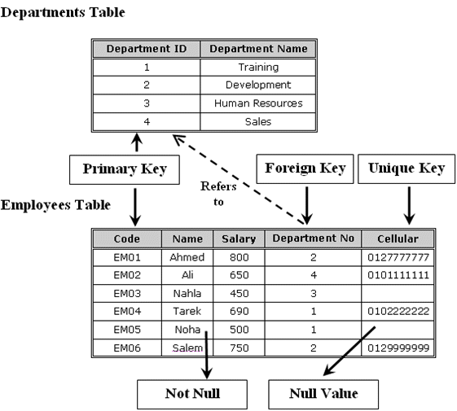

Slide 24
Database Relationships

Slide 25
Relationship Types
One-to-one relationship
One-to-many relationship
Many-to-many relationship
Recursive relationship
Referential integrity

Slide 26
One To One Relationships
One Record
One Record

Slide 27
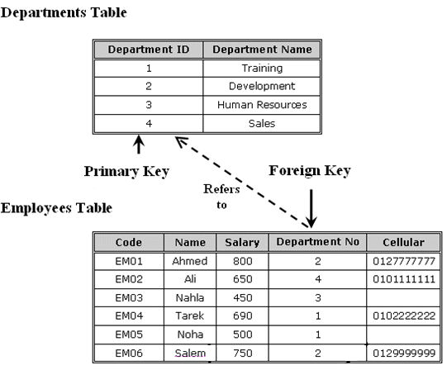
One To Many Relationships

Slide 28
One To Many Relationships
One Record
Record 1
Record 2
Record 3

Slide 29
Many To Many Relationships
Record 1
One Record
Record 1
Record 2
Record 2
Record 3
Record 3

Slide 30
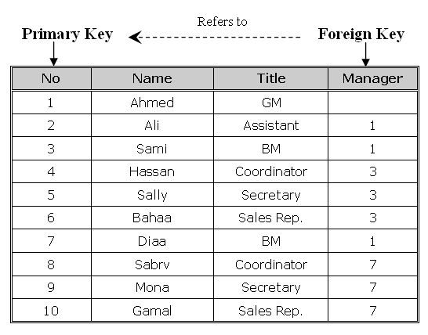
Recursive relationship

Slide 31
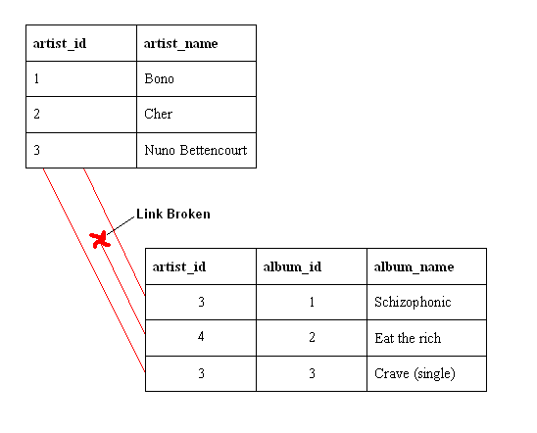
Referential integrity
You cannot add a value in a foreign key without a matching value in a primary key.
it prevents deleting a primary key that there is a foreign key related to it

Slide 32
Database Normalization

Slide 33
Normalization Overview
Definition
the process of organizing data to minimize redundancy
the process of decomposing large, inefficiently structured tables into smaller, more efficiently structured tables without losing any data in the process .
the process of reducing tables to a set of columns where all the non-key columns depend on the primary key column

Slide 34
First normal form
rules
Table must describe only a single object.
A single field must not contain multiple data values.
Table must not include repeated fields in the same column.
Repeated fields must be removed to a related table.
Create separate tables for each group of related data.
Identify each row with a unique identifier (primary key).

Slide 35
Problem
The CourseCategory column contains repeated values for the rows.
The CourseInfo column contains multiple data values in each field
Solution
CourseCategory > to separate table (Categories)
One-Many relationships (Category to Course )
CourseInfo > to two columns(start date , branch)
You need to create branches Tables .

Slide 36
Second normal form
rules
Meet all the requirements of the first normal form.
Data in all non-key columns must fully depend on the value of the primary key column or the composite primary key columns.

Slide 37
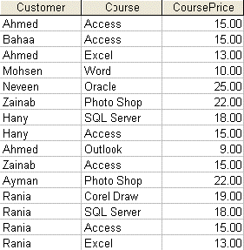
Example

Slide 38
Problem
CoursePrice depending only on the course column
Solution
CoursePrice column > Course Table

Slide 39
Third normal form
Rules
Meet all the requirements of the first normal form.
Meet all the requirements of the second normal form.
Data in all non-key columns must fully describe the value of the primary key column or the composite primary key columns.

Slide 40
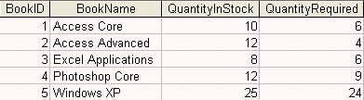
Example

Slide 41
Problem
QuantityInStock column and the QuantityRequired
Solution
QuantityInStock column and the QuantityRequired column must be removed to the book transactions table that fully describes the stock control for the books rather than describing the book itself as an object

Slide 42
Denormalization
Definition
the opposite of normalization
Why
to optimize the performance of a database
if many relations are joined, it may be too slow then to retrieve information

Slide 43
SQL Queries

Slide 44
Working with Oracle 12C

Slide 45
Introduction to Oracle SQL

Slide 46
SQL Commands
Data Definition Language (DDL)
Create , Alter , Drop , Truncate, Replace, Comment
deal with the structure of the database objects (the object itself) like tables, views, procedures and so on.
Data Manipulation Language (DML)
Select, Insert , Delete , Update , Merge
deal with the contents of the tables rather than the structure of the tables
Data Control Language (DCL)
Grant, Revoke
maintain security of the database objects access and use
Transaction Control
Commit, Rollback, Savepoint

Slide 47
Data Definition Language (DDL)
CREATE
adding a new database object to the database
ALTER
changing the structure of an existing database object
DROP
removing a database object from the database permanently
TRUNCATE
removing all rows from a table without logging the individual row deletions
COMMENT
Add comments to the data dictionary

Slide 48
Data Manipulation Language (DML)
SELECT
retrieving data from the database by specifying which columns and rows to be retrieved
INSERT
adding a new row (and not column) into the table
UPDATE
modifying the existing data in the tabl
DELETE
removing an existing data from the table
Merge(Upsert)
performs a series of conditional Update and/or Delete and/or Insert operations

Slide 49
Data Control Language (DCL)
GRANT
giving privileges to the users
REVOKE
removing privileges from the users that are previously granted those permissions

Slide 50
Retrieving Data Customizing Data

Slide 51
SELECT
Definition
Retrieve data from database
Syntax
SELECT * | column1 [, column2, …….]
FROM table
[WHERE conditions]
[ORDER BY column1 [, column2, ……..] ASC, DESC]

Slide 52
WHERE
Definition
Specify a condition to limit the result
Syntax
SELECT * | column1 [, column2, …….]
FROM table
[WHERE conditions]

Slide 53
Order BY
Definition
sort the retrieved rows by a specific column or set of columns
Syntax
SELECT * | column1 [, column2, …….]
FROM table
[WHERE conditions]
[ORDER BY column1 [, column2, ……..] ASC, DESC]

Slide 54
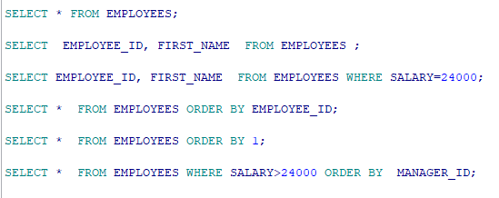
Example
Notes:
SELECT * FROM EMPLOYEES;
SELECT EMPLOYEE_ID, FIRST_NAME FROM EMPLOYEES ;
SELECT EMPLOYEE_ID, FIRST_NAME FROM EMPLOYEES WHERE SALARY=24000;
SELECT * FROM EMPLOYEES ORDER BY EMPLOYEE_ID;
SELECT * FROM EMPLOYEES ORDER BY 1;
SELECT * FROM EMPLOYEES WHERE SALARY>24000 ORDER BY MANAGER_ID;

Slide 55
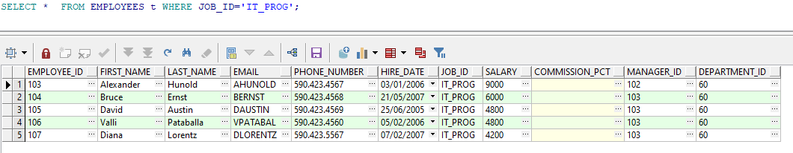
Example

Slide 56
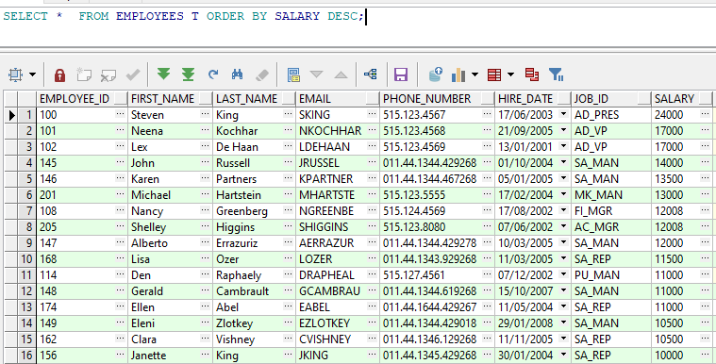
Example

Slide 57
SQL AND & OR Operators
AND
The AND operator displays a record if both the first condition AND the second condition are true.
OR
The OR operator displays a record if either the first condition OR the second condition is true.
SELECT *
FROM EMPLOYEES
WHERE LAST_NAME = 'King'
AND JOB_ID = 'IT_PROG';
SELECT *
FROM EMPLOYEES
where JOB_ID = 'SA_REP'
OR JOB_ID = 'IT_PROG';
Notes:
SELECT *
FROM EMPLOYEES
WHERE LAST_NAME = 'King'
AND JOB_ID = 'IT_PROG';
SELECT *
FROM EMPLOYEES
where job_id = 'SA_REP'
OR job_id = 'IT_PROG';

Slide 58
NULL
In the database world, NULL is special. It is a marker for missing information or the information is not applicable
SELECT * FROM EMPLOYEES WHERE MANAGER_ID IS NULL;
SELECT * FROM EMPLOYEES WHERE MANAGER_ID IS NOT NULL;
SELECT EMPLOYEE_ID, COMMISSION_PCT, NVL(COMMISSION_PCT, 0)
FROM EMPLOYEES t;

Slide 59
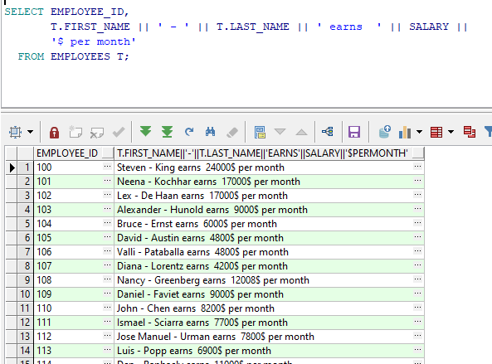
Concatenate

Slide 60
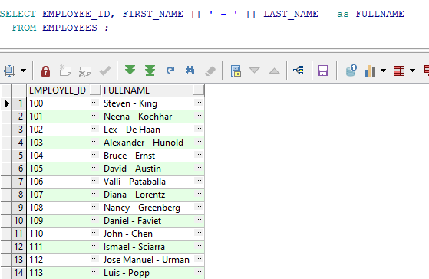
Aliases (as)

Slide 61
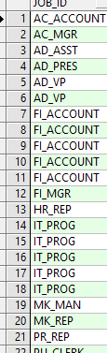
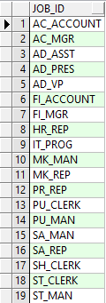
Distinct
eliminates duplicate row values from the results
SELECT JOB_ID FROM EMPLOYEES ;
SELECT DISTINCT JOB_ID FROM EMPLOYEES ;
1
2
2
1

Slide 62
Grouping Data

Slide 63
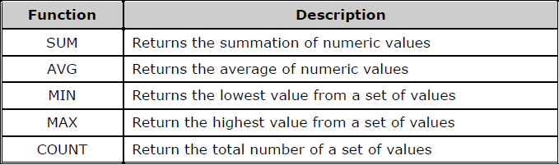
Grouping Functions

Slide 64
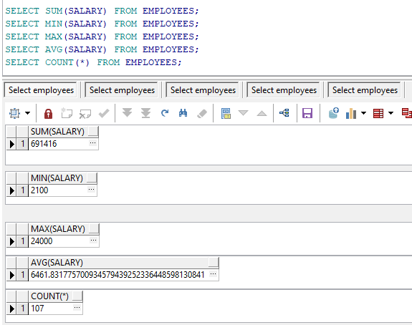
Example 1
Notes:
SELECT SUM(SALARY) FROM EMPLOYEES;
SELECT MIN(SALARY) FROM EMPLOYEES;
SELECT MAX(SALARY) FROM EMPLOYEES;
SELECT AVG(SALARY) FROM EMPLOYEES;
SELECT COUNT(*) FROM EMPLOYEES;
SELECT COUNT(MANAGER_ID) FROM EMPLOYEES;
SELECT COUNT(EMPLOYEE_ID) FROM EMPLOYEES;

Slide 65
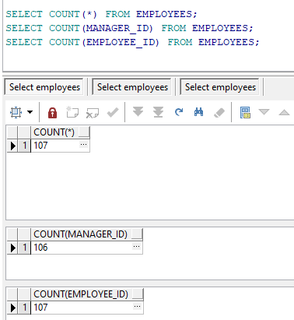
Example 2

Slide 66
Group By
Definition
used to divide the rows in a table into smaller groups
Syntax
SELECT column1, group_function (column2), …….
FROM table
[WHERE conditions]
[GROUP BY column1, ……..]
[ORDER BY column1 [, column2, ……..] ASC, DESC]

Slide 67
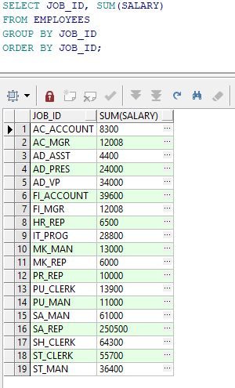
Example : Group By

Slide 68
Having
Definition
used to restrict the group results
Syntax
SELECT * | column1, group_function (column2), …….
FROM table
[WHERE conditions]
[GROUP BY column1, ……..]
HAVING [conditions]
[ORDER BY column1 [, column2, ……..] ASC, DESC]

Slide 69
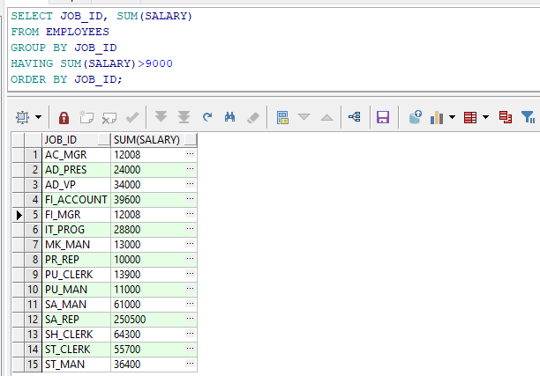
Example : Having

Slide 70
SQL Operators

Slide 71
Using SQL Operators
Arithmetic operators
Comparison operators
Logical operators
Set Operators
Other operators

Slide 72
Arithmetic operators
addition (+)
subtraction (-)
multiplication (*)
division (/).

Slide 73
Comparison operators
compare two or more values
Description | Operator
Equal | =
Lease than | <
Greater than | >
Less than or equal | <=
Greater than or equal | >=
Not Equal | <>

Slide 74
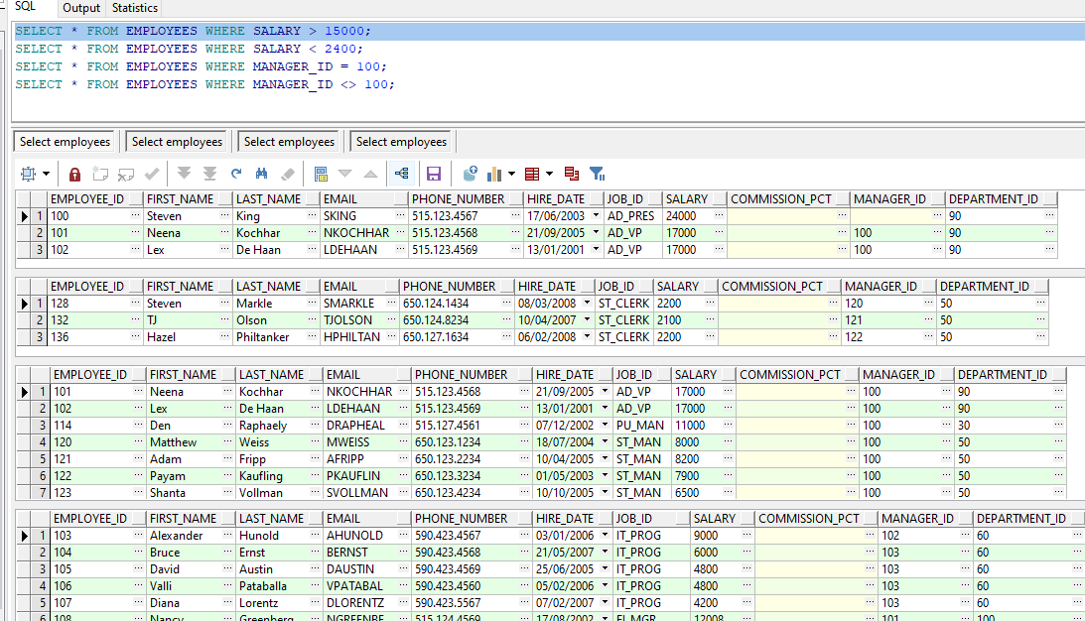
Example
Notes:
SELECT * FROM EMPLOYEES WHERE SALARY > 15000;
SELECT * FROM EMPLOYEES WHERE SALARY < 2400;
SELECT * FROM EMPLOYEES WHERE MANAGER_ID = 100;
SELECT * FROM EMPLOYEES WHERE MANAGER_ID <> 100;

Slide 75
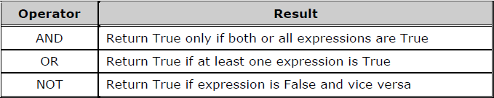
Logical operators
Used to get a logical value (True or False)

Slide 76
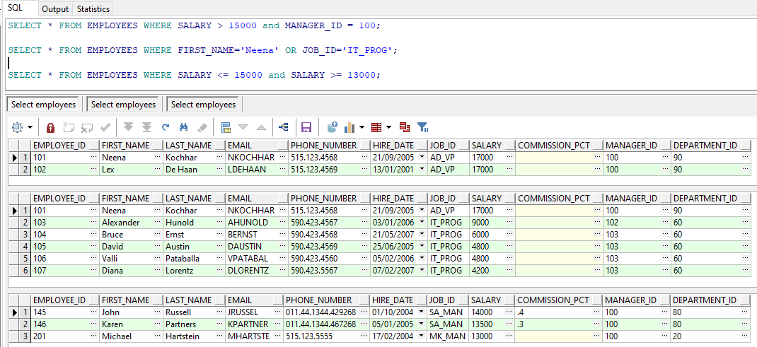
Example
Notes:
SELECT * FROM EMPLOYEES WHERE SALARY > 15000 and MANAGER_ID = 100;
SELECT * FROM EMPLOYEES WHERE FIRST_NAME='Neena' OR JOB_ID='IT_PROG';
SELECT * FROM EMPLOYEES WHERE SALARY <= 15000 and SALARY >= 13000;

Slide 77
Set Operators
Definition
combine the results of two or more queries into one result
Keywords
UNION/ UNION ALL
INTERSECT
MINUS

Slide 78
UNION & Intersect & Minus
EmpLacation
Egypt
Canada
Egypt
VacLocation
Egypt
Canada
France
Union
Egypt
Canada
France
Intersect
Egypt
Canada
Except
France

Slide 79
UNION/UNION ALL Operator
Create a Single Result Set from Multiple Queries
Each Query Must Have:
Similar data types
Same number of columns
Same column order in select list
The UNION operator returns only distinct rows that appear in either result

Slide 80
INTERSECT Operator
Definition
returns only the records that have the same values in the selected columns in both tables.
Syntax
USE northwind
SELECT (firstname + ' ' + lastname) AS name ,city, postalcode
FROM employees
INTERSECT
SELECT companyname, city, postalcode
FROM customers
GO

Slide 81
EXCEPT Operator
Definition
return rows returned by the first query that are not present in the second query
Syntax
USE northwind
SELECT (firstname + ' ' + lastname) AS name ,city, postalcode
FROM employees
EXCEPT
SELECT companyname, city, postalcode
FROM customers
GO

Slide 82
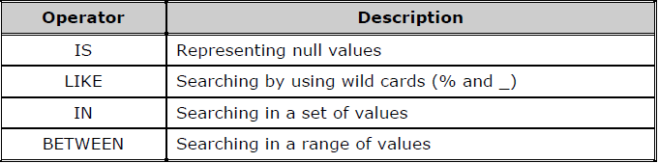
Other operators

Slide 83
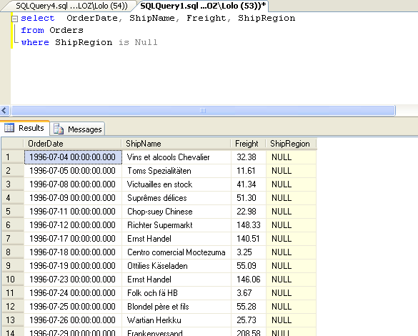

Slide 84
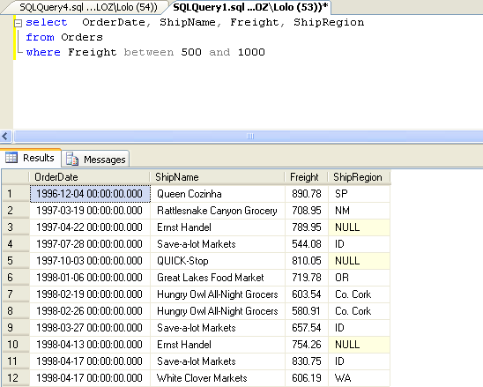

Slide 85
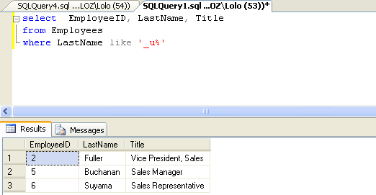

Slide 86
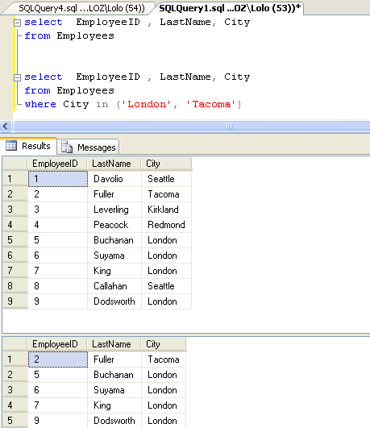

Slide 87
Joining Data

Slide 88
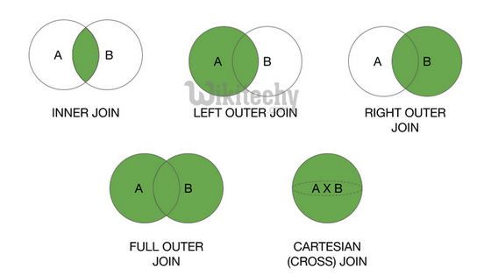

Slide 89
Using Aliases for Table Names
Example 1 (without an alias name)
Example 2 (with an alias name)
SELECT Customers.CustomerName, Orders.OrderID FROM Customers INNER JOIN Orders ON Customers.CustomerID=Orders.CustomerID ORDER BY Customers.CustomerName;
SELECT c.CustomerName, Or.OrderID FROM Customers as c INNER JOIN Orders as Or ON c.CustomerID=Or.CustomerID ORDER BY c.CustomerName;
This slide from 2071b from Microsoft

Slide 90
Combining Data from Multiple Tables
Introduction to Joins
Using Inner Joins
Using Outer Joins
Using Cross Joins
Joining More Than Two Tables
Joining a Table to Itself

Slide 91
Introduction to Joins
Selects Specific Columns from Multiple Tables
JOIN keyword specifies that tables are joined and how to join them
ON keyword specifies join condition
Queries Two or More Tables to Produce a Result Set
Use primary and foreign keys as join conditions
Use columns common to specified tables to join tables

Slide 92
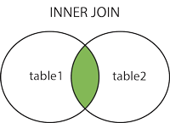
Inner Join
Definition
return rows only when there is at least one row from both tables that matches the join condition
Syntax
SELECT <select list>
FROM table1 inner join table2
ON (table1.column1 = table2.column2)

Slide 93
Using Inner Joins
USE joindb
SELECT buyer_name, sales.buyer_id, qty
FROM buyers INNER JOIN sales
ON buyers.buyer_id = sales.buyer_id GO
Example 1
buyers
sales
buyer_name
buyer_id
buyer_id
prod_id
qty
Adam Barr
1
1
2
15
Sean Chai
2
1
3
5
Eva Corets
3
4
1
37
Erin O’Melia
4
3
5
11
Result
4
2
1003
buyer_name
buyer_id
qty
Adam Barr
1
15
Adam Barr
1
5
Erin O’Melia
4
37
Eva Corets
3
11
Erin O’Melia
4
1003

Slide 94
Left Outer Join
Definition
includes all rows in the left table in the results whether or not there are matching values on the common column in the right table. in addition to the matching values in Both table.
In other words: All rows from the Left table are returned
Syntax
SELECT <select list>
FROM table1 left outer join table2
ON (table1.column1 = table2.column2)

Slide 95
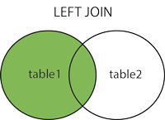
SELECT Customers.CustomerName, Orders.OrderID FROM Customers LEFT JOIN Orders ON Customers.CustomerID=Orders.CustomerID ORDER BY Customers.CustomerName;

Slide 96
Using Outer Joins
USE joindb
SELECT buyer_name, sales.buyer_id, qty
FROM buyers LEFT OUTER JOIN sales
ON buyers.buyer_id = sales.buyer_id GO
Example 1
buyers
sales
buyer_name
buyer_id
buyer_id
prod_id
qty
Adam Barr
1
1
2
15
Sean Chai
2
1
3
5
Eva Corets
3
4
1
37
Erin O’Melia
4
3
5
11
Result
4
2
1003
buyer_name
buyer_id
qty
Adam Barr
1
15
Adam Barr
1
5
Erin O’Melia
4
37
Eva Corets
3
11
Erin O’Melia
4
1003
Sean Chai
NULL
NULL

Slide 97
Right Outer join
Definition
the reverse of LEFT OUTER joins
All rows from the right table are returned
Null values are returned for the left table any time a right table row has no matching row in the left table.
Syntax
SELECT <select list>
FROM table1 right outer join table2
ON (table1.column1 = table2.column2)

Slide 98
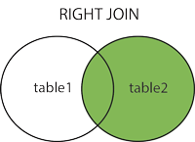
SELECT Orders.OrderID, Employees.FirstName FROM Orders RIGHT JOIN Employees ON Orders.EmployeeID=Employees.EmployeeID ORDER BY Orders.OrderID;
In some databases RIGHT JOIN is called RIGHT OUTER JOIN.

Slide 99
Full Join
returns all the rows from the left table , and all the rows from the right table
Also it returns rows in the left table that do not have matches in the right table, or if there are rows in right table that do not have matches in the left table.

Slide 100
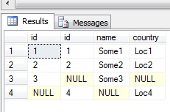
Name | ID
Some1 | 1
Some2 | 2
Some3 | 3
Country | ID
Loc1 | 1
Loc2 | 2
Loc4 | 4
SELECT a.id ,b.id, a.name , b.country
FROM LeftTable as a
Full Join RightTable as b
On a.id = b.id
Full Join

Slide 101
Self- Join
Definition
Join table with it self
Syntax
SELECT a.column , b.column
FROM Table1 as a
JOIN Table1 as b
ON a.column = b.column

Slide 102
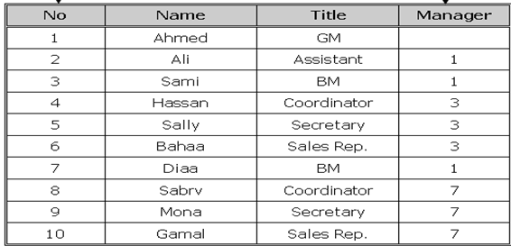
Problem
I want Every Employee Name with his Manager

Slide 103
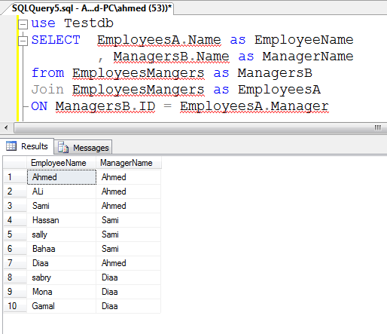
Solution

Slide 104
Cross Join
return all rows from both tables
Each row from the left table is combined with all rows from Second Table
the number of rows in the left table multiplied by the number of rows in the right table.
Table1 >> 2 rows,
Table2 >> 5 rows,
Result >>10 rows
Example :
Possible ways

Slide 105
Name
Ali
Islam
Country
Egypt
Cairo
Country | Name
Egypt | Ali
Cairo | Ali
Egypt | Islam
Cairo | Islam
Cross Join

Slide 106
Using Cross Joins
USE joindb
SELECT buyer_name, qty
FROM buyers
CROSS JOIN sales GO
Example 1
buyers
sales
Result
buyer_id
buyer_name
buyer_id
prod_id
qty
buyer_name
qty
1
Adam Barr
1
2
15
Adam Barr
15
2
Sean Chai
1
3
5
Adam Barr
5
3
Eva Corets
4
1
37
Adam Barr
37
4
Erin O’Melia
3
5
11
Adam Barr
11
4
2
1003
Adam Barr
1003
Sean Chai
15
Sean Chai
5
Sean Chai
37
Sean Chai
11
Sean Chai
1003
Eva Corets
15
...
...

Slide 107
Example
All of the possible ways that suppliers can ship their products

Slide 108
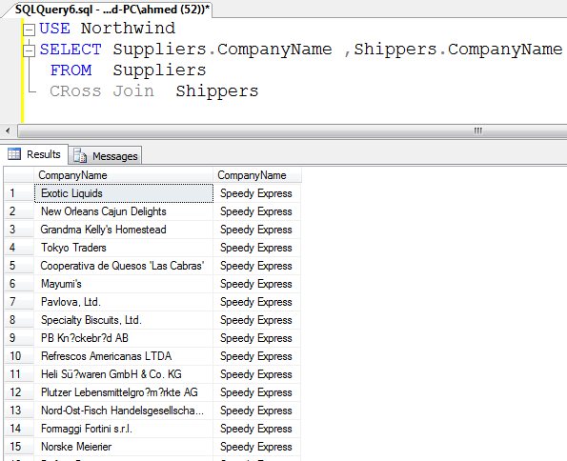

Slide 109
CASE is used to provide if-then-else type of logic to SQL. There are two formats: The first is a Simple CASE expression, where we compare an expression to static values. The second is a
Searched CASE expression, where we compare an expression to one or more logical conditions.
Simple CASE Expression
The syntax for a simple CASE expression is:
SELECT CASE ("column_name") WHEN "value1" THEN "result1" WHEN "value2" THEN "result2" ... [ELSE "resultN"] END FROM "table_name";

Slide 110
Subquery
In Oracle, a subquery is a query within a query. You can create subqueries within your SQL statements. These subqueries can reside in the WHERE clause, the FROM clause, or the SELECT clause
When a query is included inside another query, the Outer query is known as Main Query, and Inner query is known as Subquery
By: geeksforgeeks

Slide 111
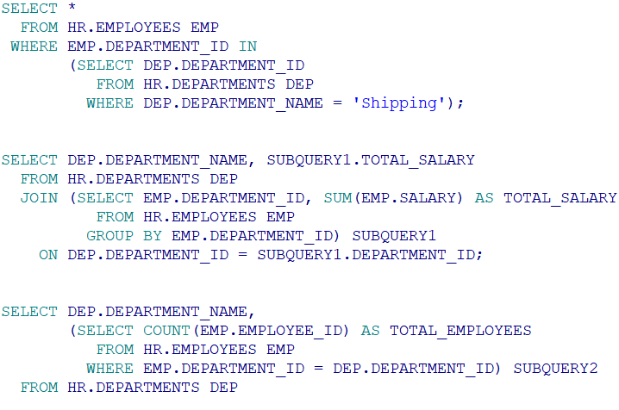
Subqueries…
WHERE clause
FROM clause
SELECT clause (Scalar Subqueries)
By: geeksforgeeks
Notes:
WHERE clause
SELECT * FROM HR.EMPLOYEES EMP
WHERE EMP.DEPARTMENT_ID IN
(SELECT DEP.DEPARTMENT_ID FROM HR.DEPARTMENTS DEP WHERE DEP.DEPARTMENT_NAME = 'Shipping’);
FROM clause
SELECT DEP.DEPARTMENT_NAME, SUBQUERY1.TOTAL_SALARY
FROM HR.DEPARTMENTS DEP
JOIN (SELECT EMP.DEPARTMENT_ID, SUM(EMP.SALARY) AS TOTAL_SALARY
FROM HR.EMPLOYEES EMP
GROUP BY EMP.DEPARTMENT_ID) SUBQUERY1
ON DEP.DEPARTMENT_ID = SUBQUERY1.DEPARTMENT_ID;
SELECT clause
SELECT DEP.DEPARTMENT_NAME,
(SELECT COUNT(EMP.EMPLOYEE_ID) AS TOTAL_EMPLOYEES
FROM HR.EMPLOYEES EMP
WHERE EMP.DEPARTMENT_ID = DEP.DEPARTMENT_ID) SUBQUERY2
FROM HR.DEPARTMENTS DEP

Slide 112
Subquery
Nested Query
In Nested Query, Inner query runs first, and only once. Outer query is executed with result from Inner query. Hence, Inner query is used in execution of Outer query
Example:
SELECT *
FROM HR.EMPLOYEES EMP
WHERE EMP.EMPLOYEE_ID IN
(SELECT JOB.EMPLOYEE_ID FROM HR.JOB_HISTORY JOB);
By: geeksforgeeks

Slide 113
Subquery
Correlated Query
In Correlated Query, Outer query executes first and for every Outer query row Inner query is executed. Hence, Inner query uses values from Outer query
Example:
SELECT *
FROM HR.EMPLOYEES EMP
WHERE EXISTS (SELECT JOB.EMPLOYEE_ID
FROM HR.JOB_HISTORY JOB
WHERE JOB.EMPLOYEE_ID = EMP.EMPLOYEE_ID);
By: geeksforgeeks

Slide 114
Join Operation
Join Operation
Join operation is a binary operation used to combine data or rows from two or more tables based on a common field between them. INNER JOIN, LEFT JOIN, RIGHT JOIN, FULL JOIN are different types of Joins
Example:
SELECT EMP.*
FROM HR.EMPLOYEES EMP
JOIN HR.JOB_HISTORY JOB
ON JOB.EMPLOYEE_ID = EMP.EMPLOYEE_ID;
By: geeksforgeeks

Slide 115
Subquery and Join Operation
Nested Query
SELECT *
FROM HR.EMPLOYEES EMP
WHERE EMP.EMPLOYEE_ID IN
(SELECT JOB.EMPLOYEE_ID FROM HR.JOB_HISTORY JOB);
Correlated Query
SELECT *
FROM HR.EMPLOYEES EMP
WHERE EXISTS (SELECT JOB.EMPLOYEE_ID
FROM HR.JOB_HISTORY JOB
WHERE JOB.EMPLOYEE_ID = EMP.EMPLOYEE_ID);
Join Operation
SELECT EMP.*
FROM HR.EMPLOYEES EMP
JOIN HR.JOB_HISTORY JOB
ON JOB.EMPLOYEE_ID = EMP.EMPLOYEE_ID;
By: geeksforgeeks

Slide 116
Subquery and Join Operation
Parameters | Nested Query | Correlated Query | Join Operation
Definition | In Nested query, a query is written inside another query and the result of inner query is used in execution of outer query. | In Correlated query, a query is nested inside another query and inner query uses values from outer query. | Join operation is used to combine data or rows from two or more tables based on a common field between them.INNER JOIN, LEFT JOIN, RIGHT JOIN, FULL JOIN are different types of Joins.
Approach | Bottom up approach i.e. Inner query runs first, and only once. Outer query is executed with result from Inner query. | Top to Down Approach i.e. Outer query executes first and for every Outer query row Inner query is executed. | It is basically cross product satisfying a condition.
Dependency | Inner query execution is not dependent on Outer query. | Inner query is dependent on Outer query. | There is no Inner Query or Outer Query. Hence, no dependency is there.
Performance | Performs better than Correlated Query but is slower than Join Operation. | Performs slower than both Nested Query and Join operations as for every outer query inner query is executed. | By using joins we maximize the calculation burden on the database but joins are better optimized by the server so the retrieval time of the query using joins will almost always be faster than that of a subquery.
By: geeksforgeeks

